Slide 1
Graphical Excellence or Graphical Disasters?
Fateme Rajabiyazdi October 2017
Based on Edward Tufte,
The Visual Display of Quantitative Information, Graphics Press, 1983.

Slide 2
Plan for this Week
Tuesday
Tufte graphical theory
Graphical examples
Causes of poor graphics
Guidelines for graphics
Thursday
Exercise how to critique a vis
Give you example of a bad visualizations

Slide 3
Tufte Graphical Theory
Notes:
Tufte has many guides in his books.
We are going to talk about several of them here.

Slide 4
Show
Show the data
Avoid
Avoid distorting the data
Encourage
Encourage visual comparisons
Reveal
Reveal data in several levels of details
Serve
Serve a clear purpose (description, tabulation, decoration)
Integrate
Integrate data closely with text descriptions
Notes:
These are just examples of rules that can help you make successful graphics. But what are the characteristics of a good graphic?
https://moz.com/blog/data-visualization-principles-lessons-from-tufte

Slide 5
Graphical Excellence
- is the well-designed presentation of interesting data
- consists of complex ideas communicated with clarity, precision, efficiency
- gives the viewer the greatest number of ideas in the shortest time with the least ink, in the smallest space
Notes:
Graphical Excellence begins with Graphical Integrity… we are going to talk about the last item in more details today…

Slide 6
Graphical Excellence
Fundamental graphic designs include:
Data maps
Time series
Space-time narrative
Relational graphics
Notes:
DM: these involve placement of additional information spatially situated on a spatially explicit diagram.
TS: these involve plotting some data as it changes across time.
ST:plotting changes across both space and time.
RG:designed to show the relationship between two or more data aspects.

Slide 7
1. Data Map
Notes:
these involve placement of additional information spatially situated on a explicit diagram.

Slide 8
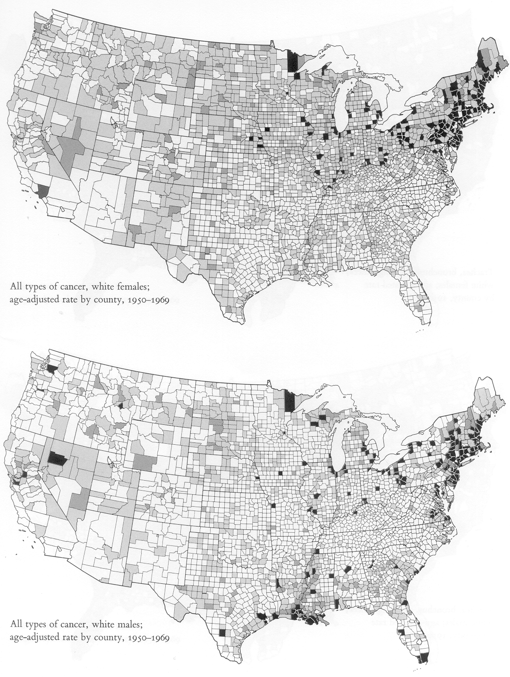
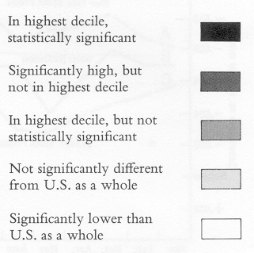
Females
Males
Atlas of Cancer Mortality in the U.S., 1950-94
Notes:
This map is showing the geographic variation age adjusted death rates by cancer among men and women across US states between 1950 and 1965.
What is this map telling you?

Slide 9
1. Data Map
Read at many levels - overall pattern to state by state detail:
High death rates in north east and around great lakes
Low rates in band down middle
Higher rates for men than women in south
Hot spots; in Minnesota, Iowa, Nebraska, along the Missouri River

Slide 10
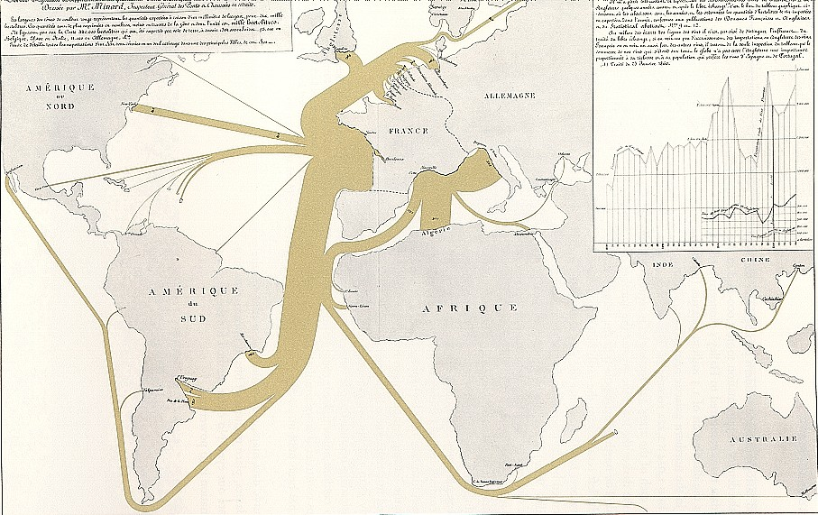
1. Data Map - 1864 Exports of French Wine
Notes:
This map shows the export rate of wine from France to other countries.

Slide 11
2. Time Series
Notes:
The time-series plot is the most frequently used form of graphic design. With one dimension marching along to the regular rhythm of seconds, minutes, hours, days, weeks, months, years, centuries, or millennia, the natural ordering of the time scale gives this design a strength and efficiency of interpretation. is the oldest known example of an attempt to show changing values graphically

Slide 12
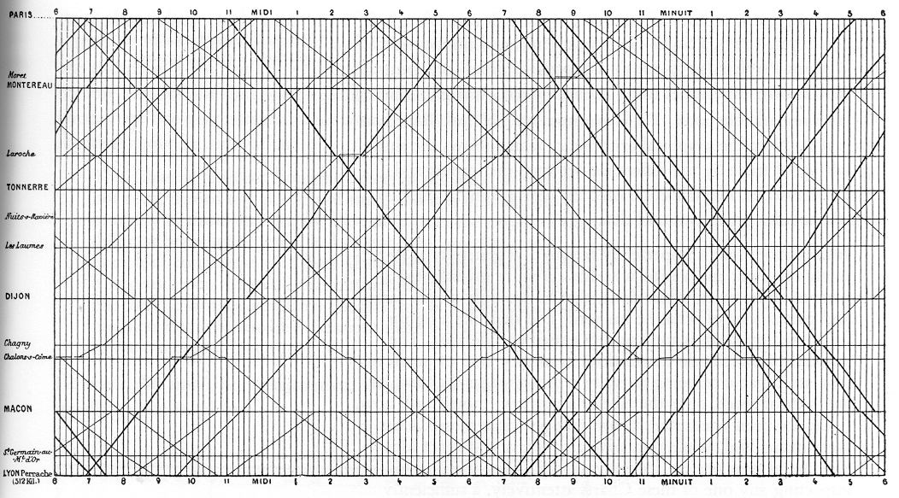
2. Time series - 1885 Train schedules Paris to Lyon
Notes:
Time it takes to go from Paris to Lyon through different stations/cities .
The top line shows the starting time and the bottom line shows the time of arrival. As you can see the slope of the line shows the speed of the train. The lines with higher slope idicate a longer journay

Slide 13
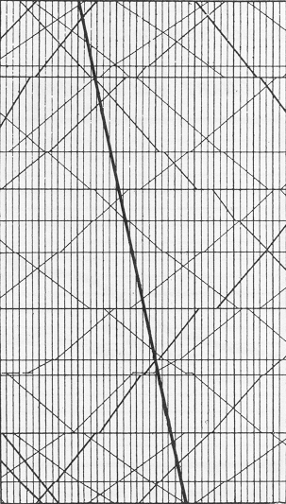
2. Time series - 1885 Train schedules Paris to Lyon
1981 – new express train trip now 3 hours instead of 9
Notes:
Once they added an express line , they reduced the journey from 9 hours to 3 hours

Slide 14
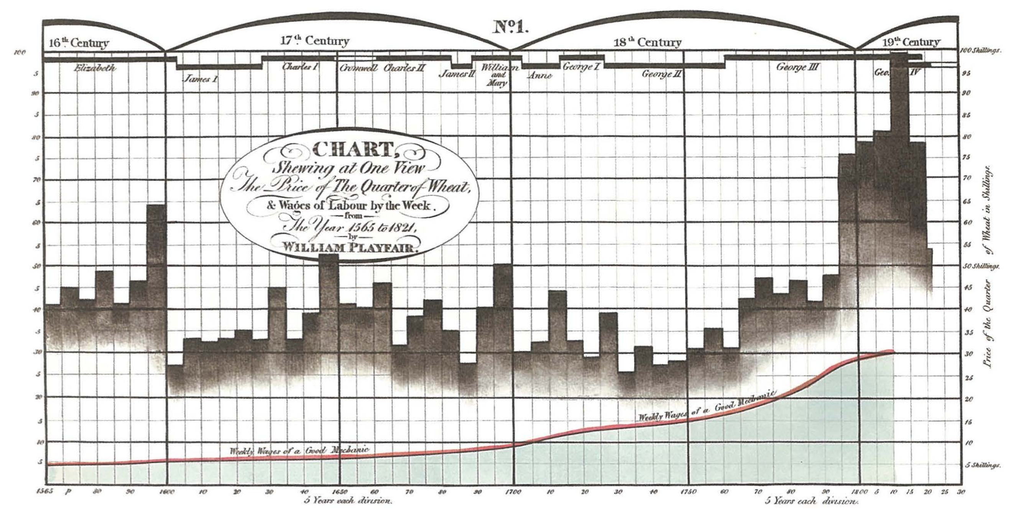
2. Time series – (1759-1823) prices, wages, reigns of kings & queens
Notes:
Question: Whether the price of wheat had increased relative to wages.
Here is another example of time series chart by Playfair.
Here we plotted three parallel time-series: prices, wages, and the reigns of British kings and queens. Between 1565 to 1821

Slide 15
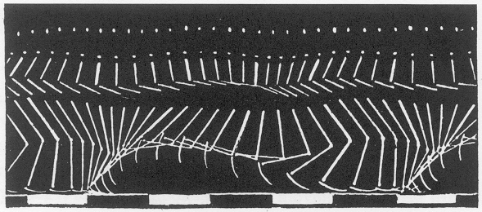
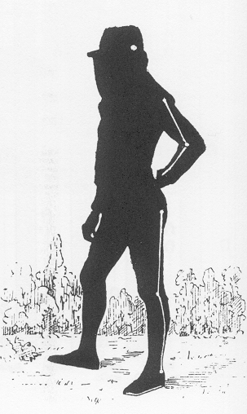
2. Time series – (1830 – 1904) diagram of motion
Notes:
Marey's man in black velvet, photographed in stick-figure images, became the time-series forerunner of Marcel Duchamp's Nude
!!!! Descending (coming down) a Staircase.

Slide 16
3. Space Time
Notes:
plotting changes across both space and time.

Slide 17
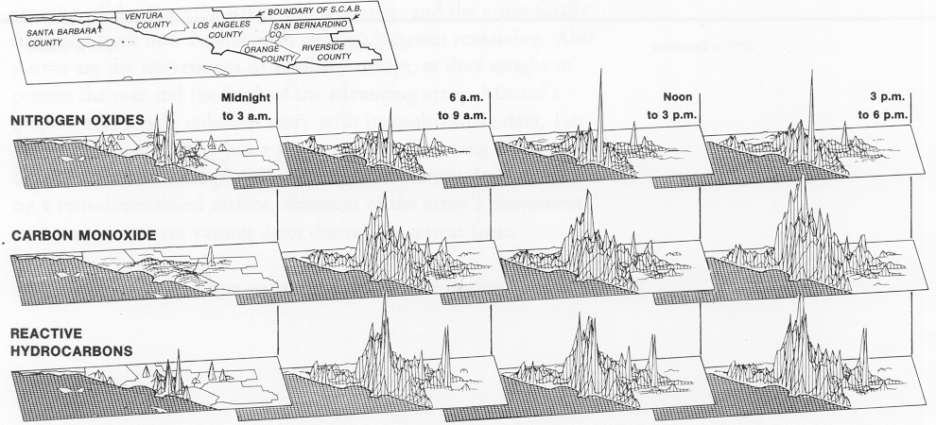
3. Space Time – Air pollution in Southern California
Notes:
we can ‘slice’ a high dimensional data set along a control dimension such as time, giving a lower dimensional set at each t value that is hopefully easier to visualise. – 1979. By varying t a series of slices is obtained, which, like the frames of a movie, we can present sequentially to recover some insight into how the data evolves through time.

Slide 18
3. Space Time – Air pollution in Southern California
Notes:
Such a sequence of static images is a simple example of a “small multiple’- a series of structurally similar charts allowing for easy comparison along the changing parameter. There is no reason why this parameter has to be time, as we can slice through any dimension of the data set; moreover, we can take a two-dimensional slice by fixing the values of two parameters and presenting the resulting visualisation as one cell of a grid

Slide 19
3. Space Time – Air pollution in Southern California
Notes:
Small multiples - Learn once - Invite comparisons

Slide 20
4. Relational Graphics
Notes:
RG:designed to show the relationship between two or more data aspects.

Slide 21
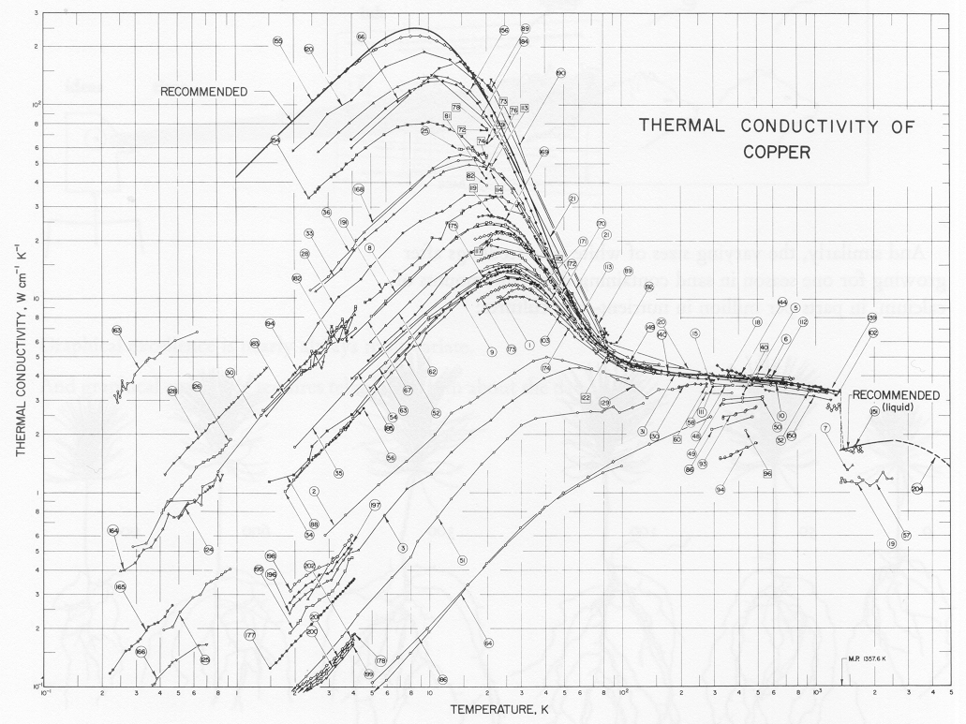
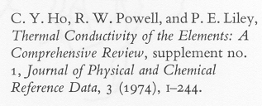
4. Relational Graphics
Relationship between temperature and thermal conductivity of copper
Notes:
Theory and measured observations diverge in the physical sciences also. Here the relationship between tempretaure and the thermal conductivity of copper assessed in a series of measurement from different laboratories. The connected points are from a single publication cit3ed by an identification number. The very different data points may be the results of diferent copper samples.

Slide 22
4. Relational Graphics
Relationship between temperature and thermal conductivity of copper
Notes:
Note that how effectively the graphic organizes a vast amount of data, recording findings of hundreds studies on a single page, at the same time enforcing comparison of the varying results.

Slide 23
Graphical Excellence - Summary
Designed for the presentation of interesting data
Consists of complex ideas communicated with clarity, precision and efficiency.
Gives to the viewer
> ideas
< time
< ink
< space
Is nearly always multivariate, and is all about truth and integrity.
Notes:
Designed for the presentation of interesting data – matter of substance, of statistics, and of design.
the greatest number of ideas in the shortest time with the least ink in the smallest space.

Slide 24
Graphical Integrity
Graphics can be a powerful communication tool
Lies and falsehoods are possible
Notes:
Graphical Integrity • “not lying with statistics” • tell the truth about dat
Worse, though, is a visualisation that is not difficult to interpret, but easy to misinterpret - that is, misrepresents the underlying data

Slide 25
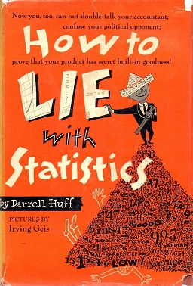

Slide 26
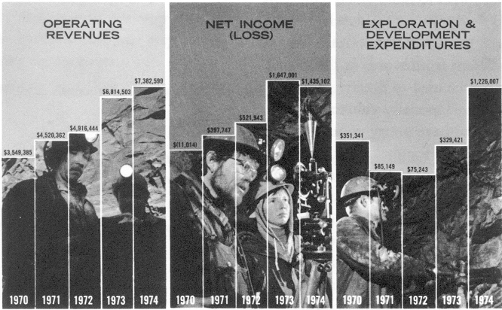
Misleading Graphics - Day Mines, Inc., 1974 Annual report
Notes:
examples of Infographics lacking integrity

Slide 27
Misleading Graphics - Day Mines, Inc., 1974 Annual report
Notes:
Where is the bottom line? What is happening in 1970?

Slide 28
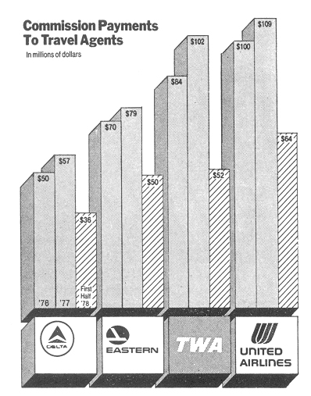
Misleading Graphics
What is wrong with this infographic?
Notes:
Order of numbers?
Magnitude of numbers? Impression?

Slide 29
Misleading Graphics
What is wrong with this infographic?
Notes:
Order of numbers?
Magnitude of numbers? Impression?

Slide 30
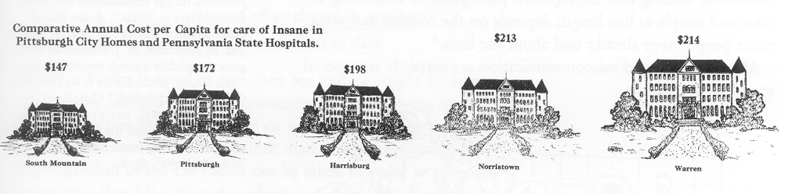
Misleading Graphics

Slide 31
Distortion in Graphics
A graphic does not distort if the visual representation is consistent with the numerical representation.
Notes:
What is distortion in a data graphic?
a graphic distorts if the visual representation of the data is inconsistent with the numerical representation.
How do we know the visual representation is consistent with numerical representation?
But the question is how do we know that the visual image represents the underlying numbers?

Slide 32
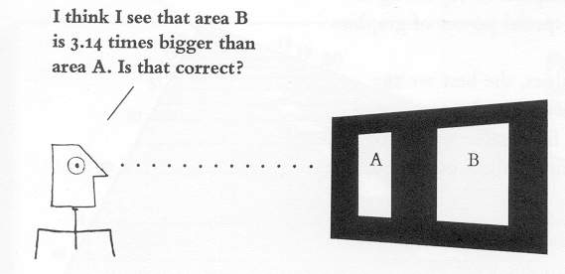
Distortion in Graphics
Notes:
One way to try to answer these questions is to conduct experiments on the visual perception of graphics, having people look at lines of varying length and circles of different areas and then record their assesments of numerical quantities.

Slide 33
Distortion in Graphics - Study
Notes:
Different ppl perceives areas differently, based on their experience and the context.
shorter

Slide 34
Distortion in Graphics - Study
reported perceived area = (actual area)^{X}, where x = 0.8±0.3
Notes:
The results of these experiements discovered a very approximate power laws relating to numerical measure to reported perceived measures.

Slide 35
Distortion in Graphics - Guidelines
The measurement of the graphic should be in proportion to the quantity.
Clear, detailed labels should explain distortion and events, on the graphic.
Notes:
The representation of numbers, as physically measured on the surface of the graphic itself, should be directly proportional to the numerical quantities represented. ( the road example)

Slide 36
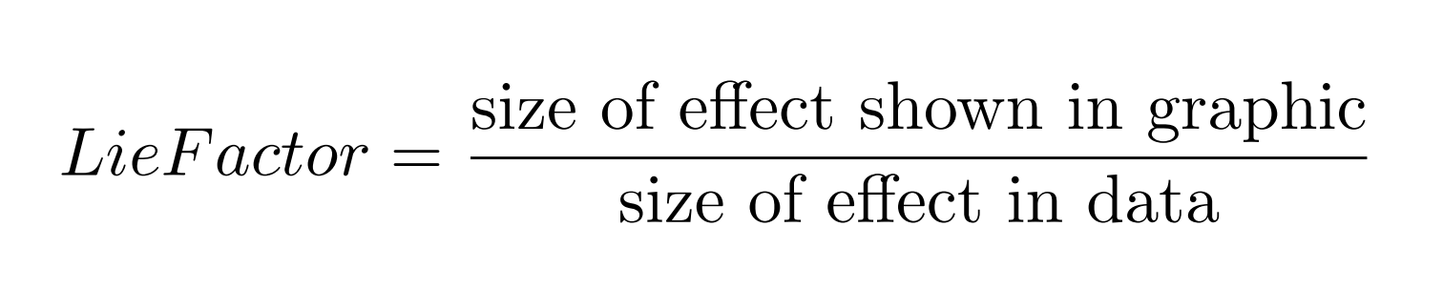
Distortion in Graphics – Lie Factor
Notes:
- If the Lie factor is equal to one 1 then the graphic is desirable and is doing a reasonable job of accurately representing the underlying numbers.
- lie factors greater than > 1.05 or smaller than < 0.95 go beyond plotting errors and are considered far beyond inaccuracies in plotting.

Slide 37
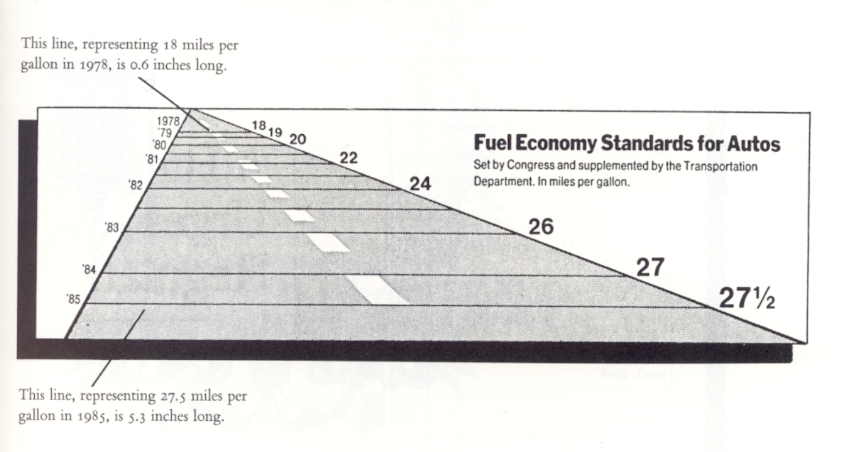
Distortion in Graphics – Extreme Examples

Slide 38
Distortion in Graphics – Extreme Examples
Fuel economy standards for automobiles increase
18 miles/gallon in 1978 to 27.5 miles/gallon in 1985
53% = (27.5 – 18.0)/(18.0) x 100
Graphic increase
783% = (5.3 – 0.6)/(0.6) x 100
Lie factor
783/53 = 14.8
Notes:
First one is a simple math
Second one is Lie Factor

Slide 39
Distortion in Graphics – Extreme Examples
Notes:
Usually the future is in front of us
Dates remain same size and fuel factors increase

Slide 40
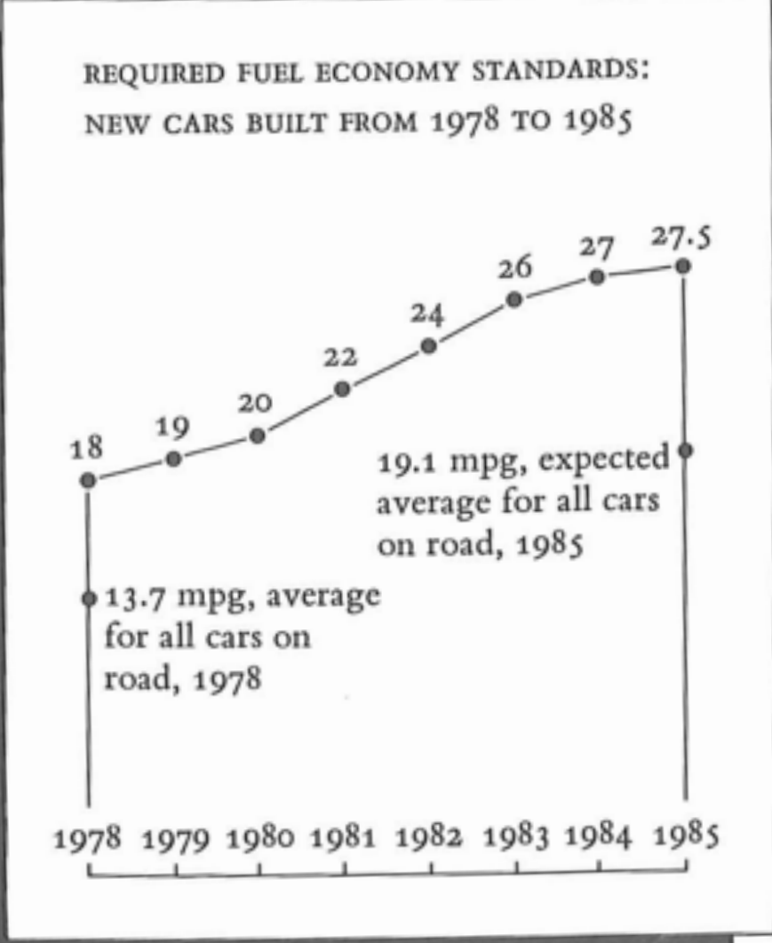
Distortion in Graphics – Extreme Examples

Slide 41
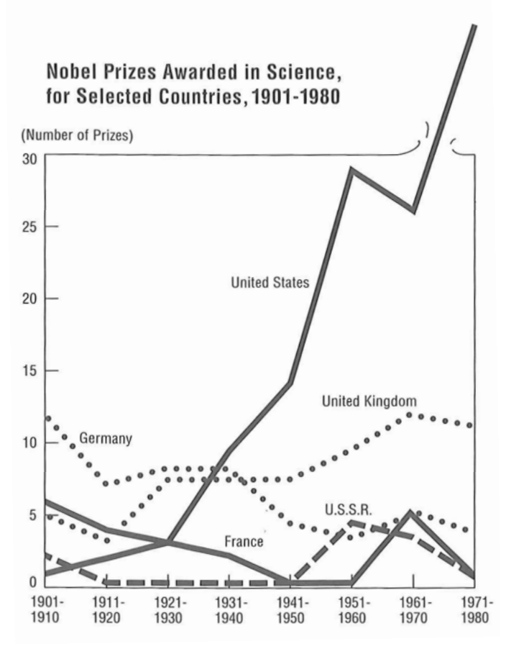
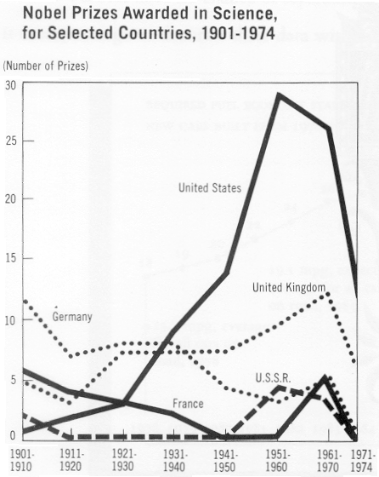
Extrapolation
Notes:
the action of estimating or concluding something by assuming that existing trends will continue or a current method will remain applicable.

Slide 42
A Campaign Map, Morphed By Money
Video

Slide 43
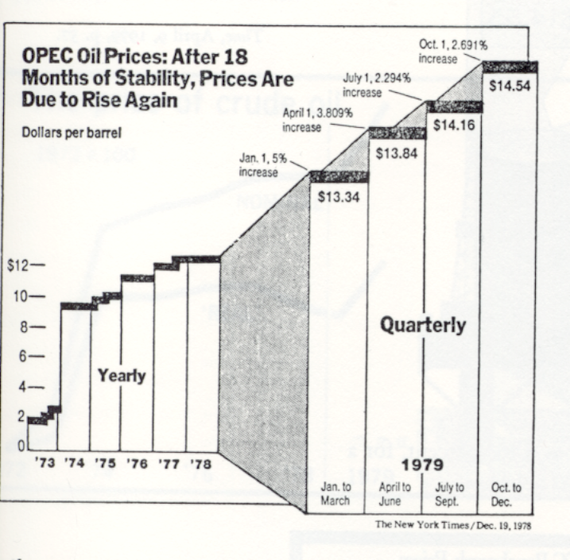
Design Variation vs Data Variation
Vertical Scales
1973 -1978 $8.00
Jan. – Mar. 1979 $4.73
Apr. – June 1979 $4.37
Jul. – Sept. 1979 $4.16
Oct. – Dec. 1979 $3.92
Horizontal Scales
1973-1978 3.8 years
0.57 years
Notes:
Show data variation not design variation

Slide 44
Design Variation vs Data Variation
- 5 different vertical scales show price
- 2 different horizontal scales show passage of time
- With both scales shifting the distortion is multiplicative
Notes:
Show data variation not design variation

Slide 45
Context Matters
Graphics must not quote data out of context

Slide 46
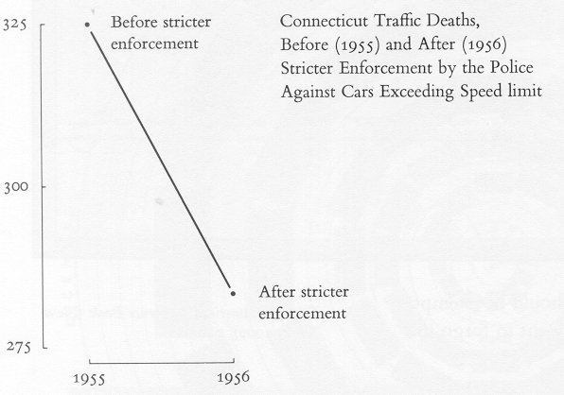
Context Matters
Data sparse graphics should provoke suspicion
Graphics often lie by omission
Nearly all important questions are left unanswered
Notes:
Before 1955 .. How long before?

Slide 47
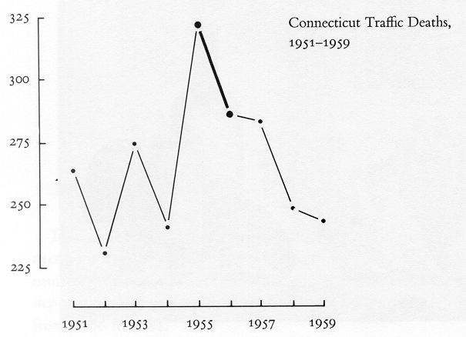
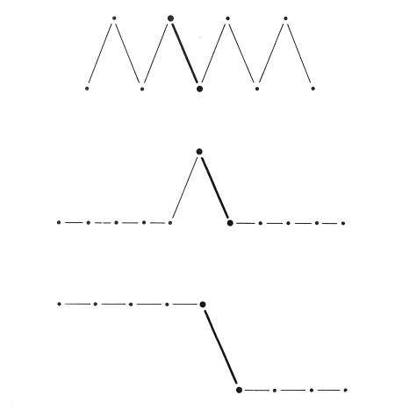
Context Matters
Notes:
The point is the traffic deaths was low before 1955 and it went down after 1957 by just slicing a portion of data, they mislead the point!
Different data points would tell a different stories

Slide 48
Graphical Integrity - Summary
The representation of numbers, as physically measured on the surface of the graphic itself, should be directly proportional to the numerical quantities represented.
Clear, detailed, and thorough labeling should be used to defeat graphical distortion and ambiguity. Write out explanations of the graphic itself. Label important events.
Show data variation, not design variation.
Graphics must not quote data out of context.

Slide 49
Causes of Poor Graphics
Why are there so few examples of good graphics?
One possible answer is lack of training
Another is societal attitudes
Common Attitudes
Data is boring
Graphics are for people who can not understand the data
Notes:
Data is boring - in spite of the fact that more and more time, money, and people hours are spent gathering data (fire hoses of data)

Slide 50
Guidelines to Create Graphics
Notes:
Tufte has a series of guidelines to help us create excellence graphics.
Data graphics should draw the viewers attention to the sense and substance of data not to something else. The data graphical form should present the quantitative contents. Occasional artfulness of design can be acceptable.

Slide 51
Guidelines to Create Graphics
Minimize ink while maximizing data ink
Maximize data density
Avoid chartjunk
Create multifunctioning graphics
Make use of parallelism (small multiples)
Consider 3D carefully
Consider colour carefully

Slide 52
1. Minimize ink while maximizing data ink
Maximize the data-ink ratio
Erase non-data ink
Revise and edit
Notes:
A large share of ink on a graphic should present data information, the ink changing as the data change.
What is ink? What is non data?

Slide 53
1. Minimize ink while maximizing data ink
Data-ink ratio
= data-ink / total ink used to print the graphic
= proportion of a graphic's ink devoted to the non-redundant display of data-information
= 1.0 – proportion of graphic that can be erased without loss of data-information
Notes:
Data ink is the non-erasable core of a graphic, non-redundant ink arranged in reposnse to variation in the numbers represented.

Slide 54
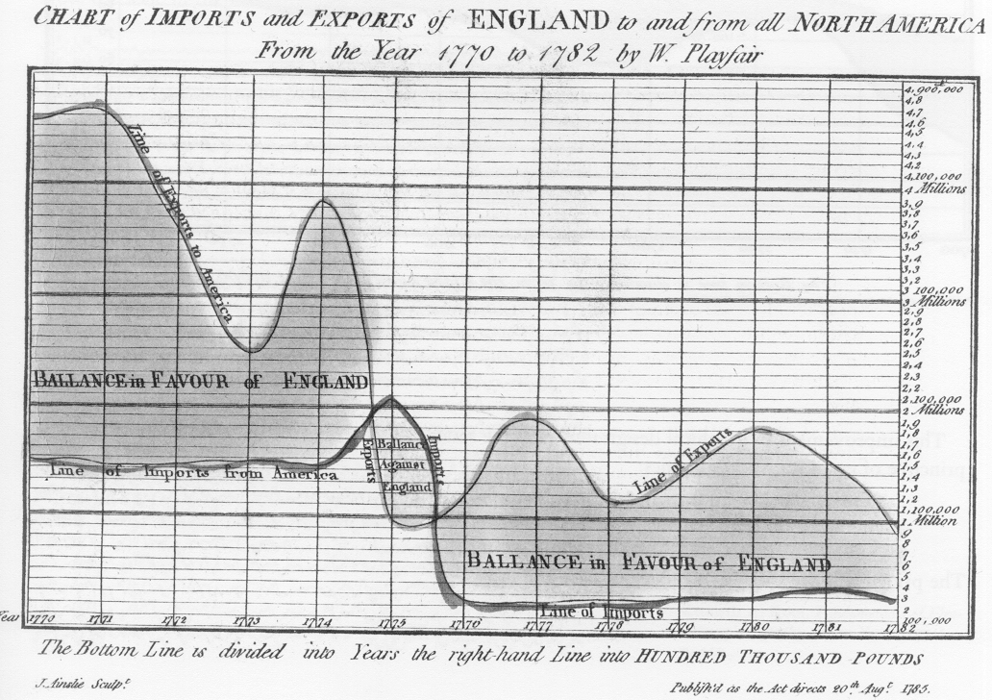
1. Minimize ink while maximizing data ink
Notes:
William Playfair’s first graphics used considerably more ink in general – august 1785

Slide 55
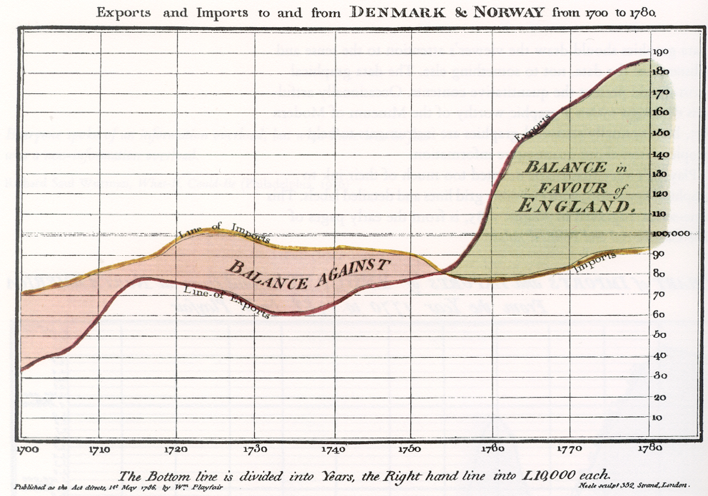
1. Minimize ink while maximizing data ink
Notes:
Less grid lines
More space between data scale
Cleaner entry lines
Succinct comments

Slide 56
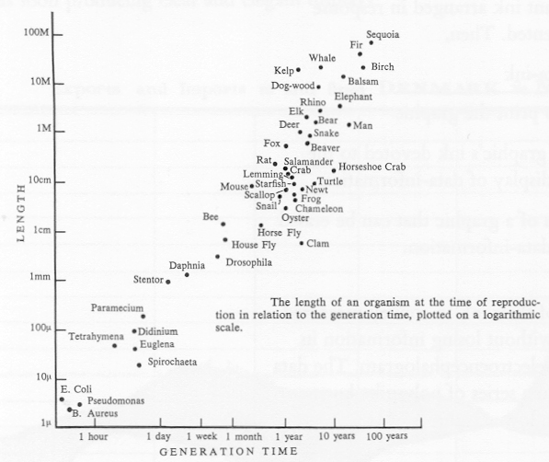
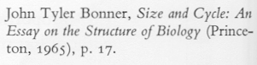
1. Minimize ink while maximizing data ink
Notes:
Most ink is being used is data-ink (the dots and the lables )

Slide 57
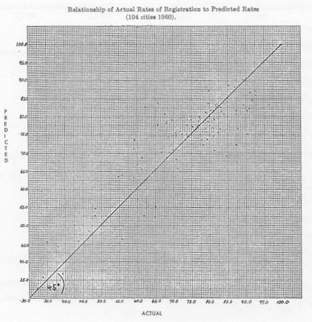
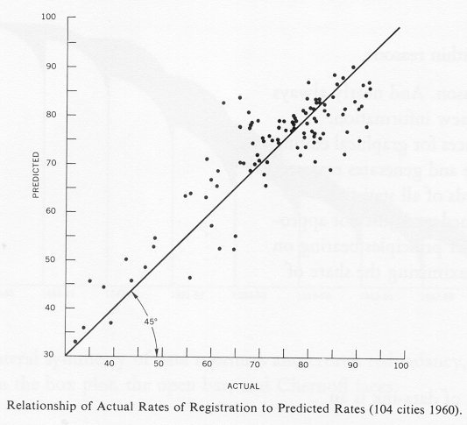
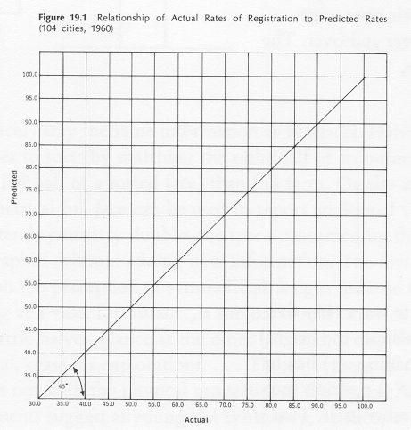
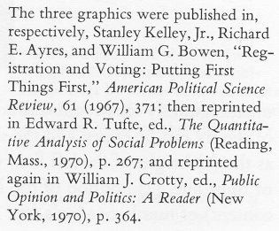
1. Minimize ink while maximizing data ink
heavy grid lines –non data ink – data hard to see
Data easy to see
Over simplified – no data present
Notes:
Actual rate of vote registration compared to predicted rate in 104 cities 1960

Slide 58
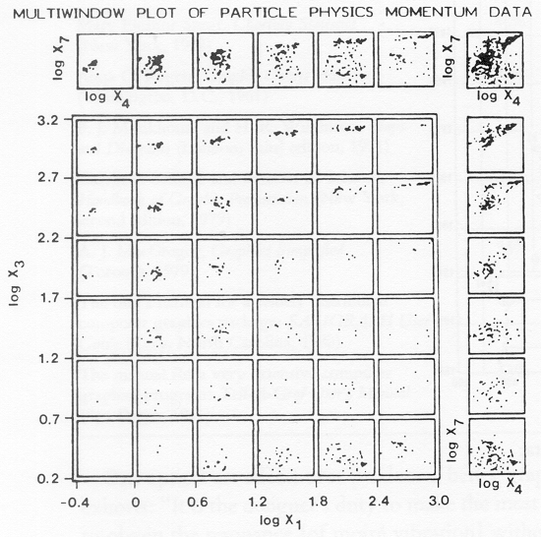
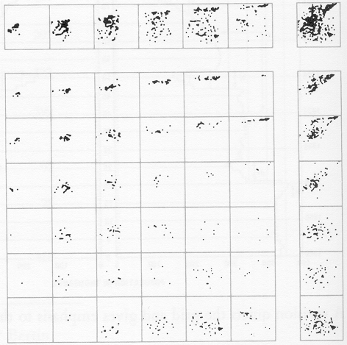
1. Minimize ink while maximizing data ink
Notes:
heavy grid lines –non data ink – actually cause irritation – chartjunk

Slide 59
2. Data density
= number of entries in the data matrix / area of the data graphic

Slide 60
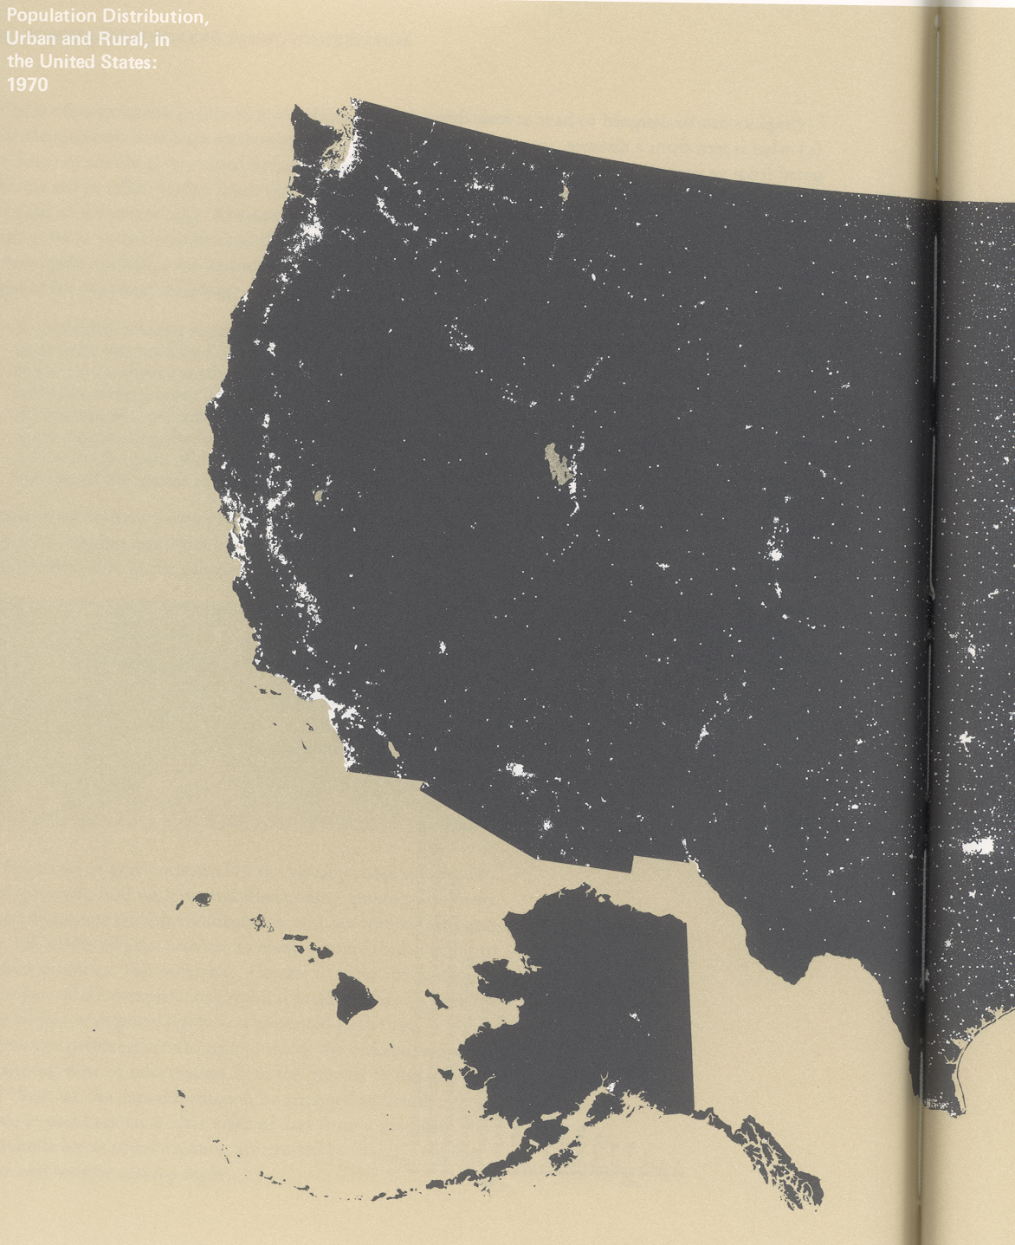
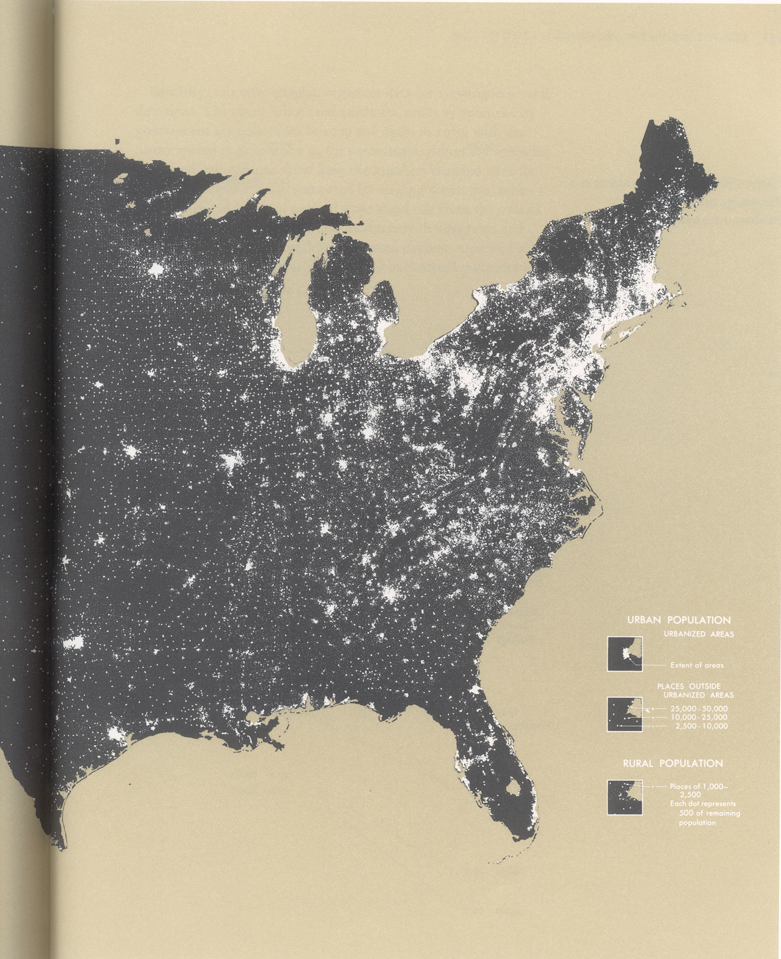
Notes:
Population distribution urban and rural in States

Slide 61
2. Data density – Viewing depth
What is seen from a distance, an overall structure usually aggregated from an underlying microstructure
What is seen close up and in detail; the fine structure of the data
The size etc. of the cities, the spread in the sparse areas
What is seen implicitly – the interrelations between the data
The effect of traffic and landscape corridors
Notes:
The overall pattern the concentrations

Slide 62
3. ChartJunk
Notes:
Chartjunk refers to all visual elements in charts and graphs that are not necessary to comprehend the information represented on the graph, or that distract the viewer from this information.

Slide 63
3. Avoid ChartJunk
Adding frills does not help
Data graphics get sold on their content
Avoid decoration
Over powering grids
Avoid unnecessary additions
Notes:
Avoid extras that does not add anything

Slide 64
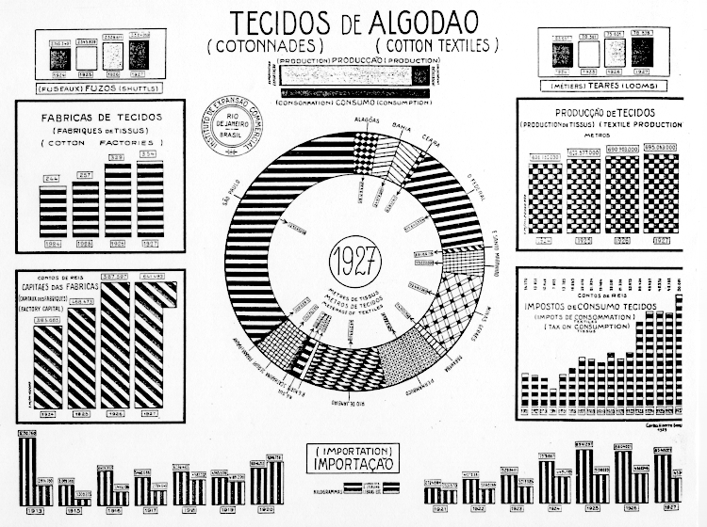
3. Avoid ChartJunk – 1927 Cotton production in Brazil
Notes:
vibrating textures

Slide 65
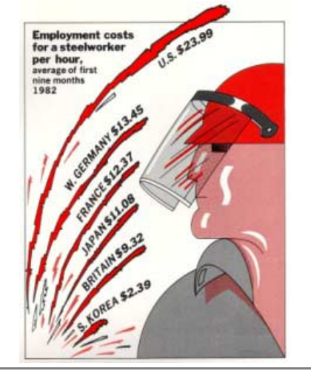
3. Avoid ChartJunk – 1982 Employment costs
Notes:
vibrating textures

Slide 66
3. Avoid ChartJunk – A Common Error
Information visualization is not just pretty graphics!!!

Slide 67
3. Avoid ChartJunk – A Common Error
More memorable is better, right? !!!

Slide 68
4. Create multifunctioning graphics
Notes:
The same ink can often serve more than one graphical purpose.

Slide 69
4. Create multifunctioning graphics
Multifunctioning graphical elements can effectively display complex data.
The principle is: mobilize every graphical element, perhaps several times over to show the data.
Avoid making puzzle graphics with encodings that can only be understood by their creator.
Notes:
The principle is: mobilize every graphical element, perhaps several times over, to show the data.

Slide 70
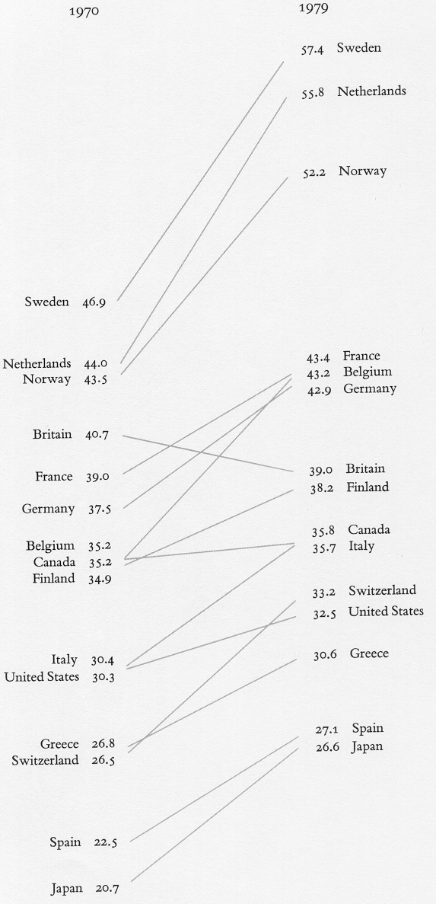
4. Create multifunctioning graphics
Reading chart vertically – ranks 15 countries by government tax collection for 1970 and 1979
Names are spaced in proportion to percentages
Paired comparisons show how numbers changed over the years

Slide 71
5. Make use of parallelism
Often there exists some parallelism in the data
This can be used do clarify which aspects of the data change
Small multiples have been used for 100s of years
Notes:
These are a series of graphics such as frames in a movie showing the same combination of variables, indexed by changes in another variable(s)

Slide 72
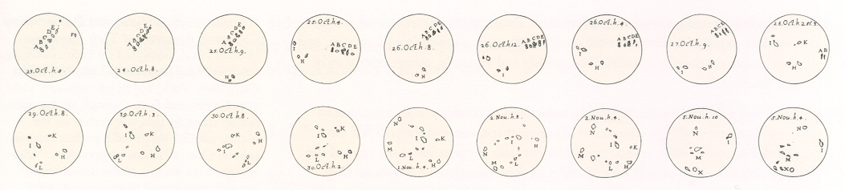
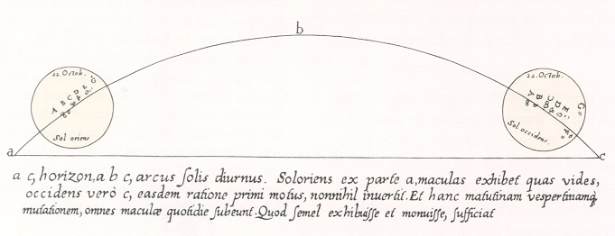
5. Make use of parallelism
Notes:
Galileo marked and labeled sunspots
Collections of these labeled drawing make small multiples
Showing sunspot location, with time and labels and the shifting orientation of the sun in our sky

Slide 73
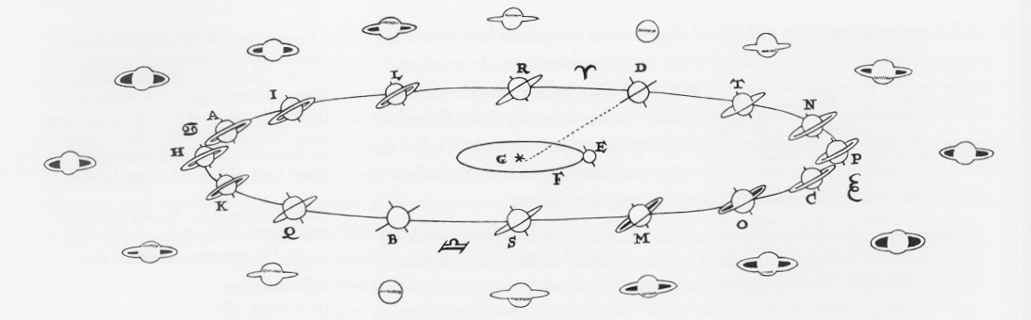
5. Make use of parallelism
Small Multiple from Huygens’ Systema Saturnium 1659.
Notes:
http://galileo.rice.edu/sci/observations/saturn.html
At the end of the nineteenth century, spectrographic studies showed that the angular rotation of the inside of the ring was greater than that of the outside of the ring, and that the ratio obeyed Kepler's third law. The problem was now solved, although Saturn's ring system still held surprises, as can be seen from the results of the recent flybys of the planet.

Slide 74
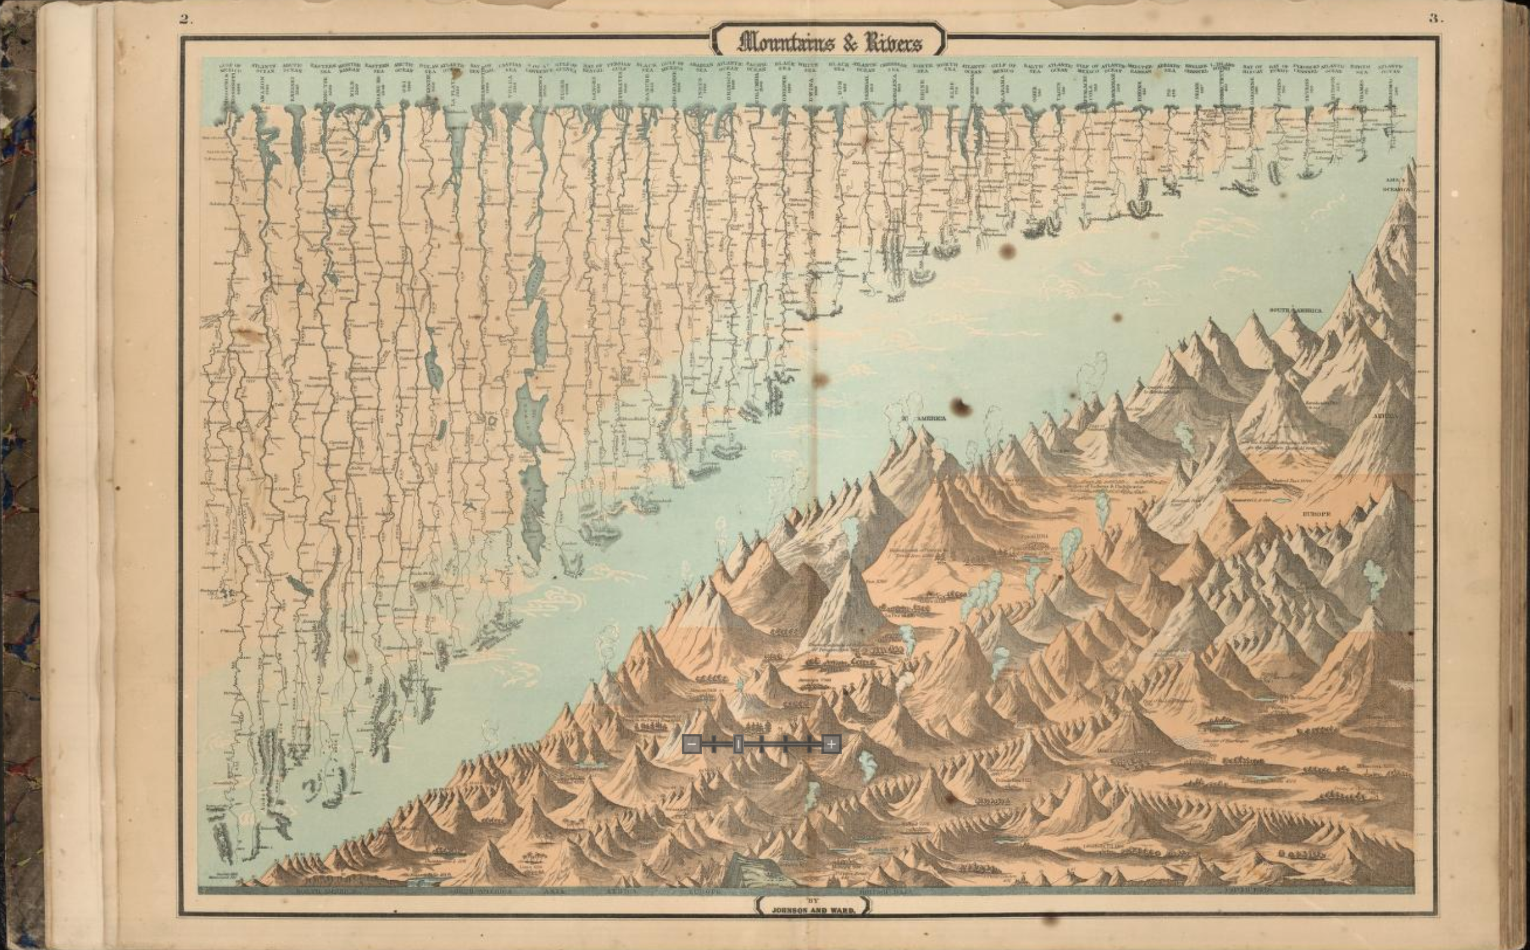
5. Make use of parallelism
Johnson’s New Illustrated Family Atlas with Physical Geography, 1864
Notes:
A Comparative Heights of Mountains and Lengths of Rivers of North America, South America, Asia, Africa, Europe, and British Isles. Relief shown by hachures.

Slide 75
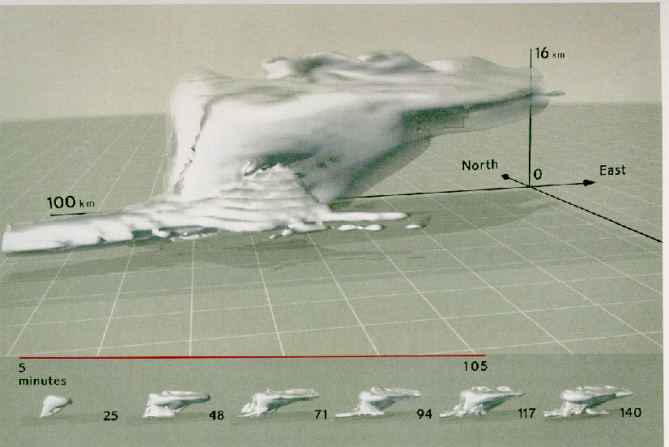
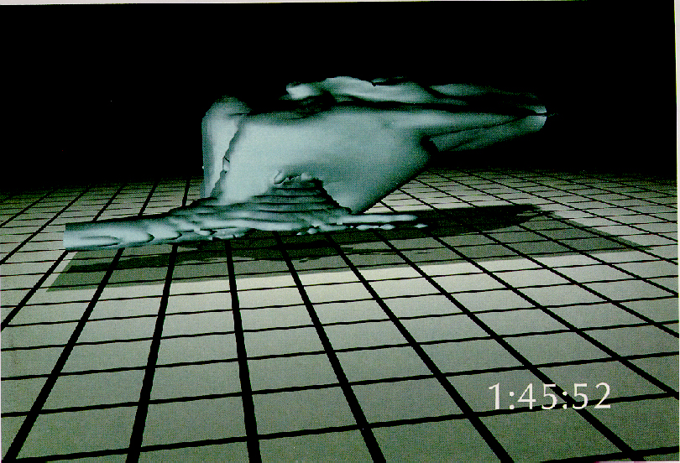
5. Make use of parallelism – show time and change

Slide 76
6. Consider 3D carefully
Notes:
EVEN though we navigate daily through a perceptual world of three spatial dimensions, the world portrayed on our information displays is caught up in the two dimentional on a screen or on a paper.

Slide 77
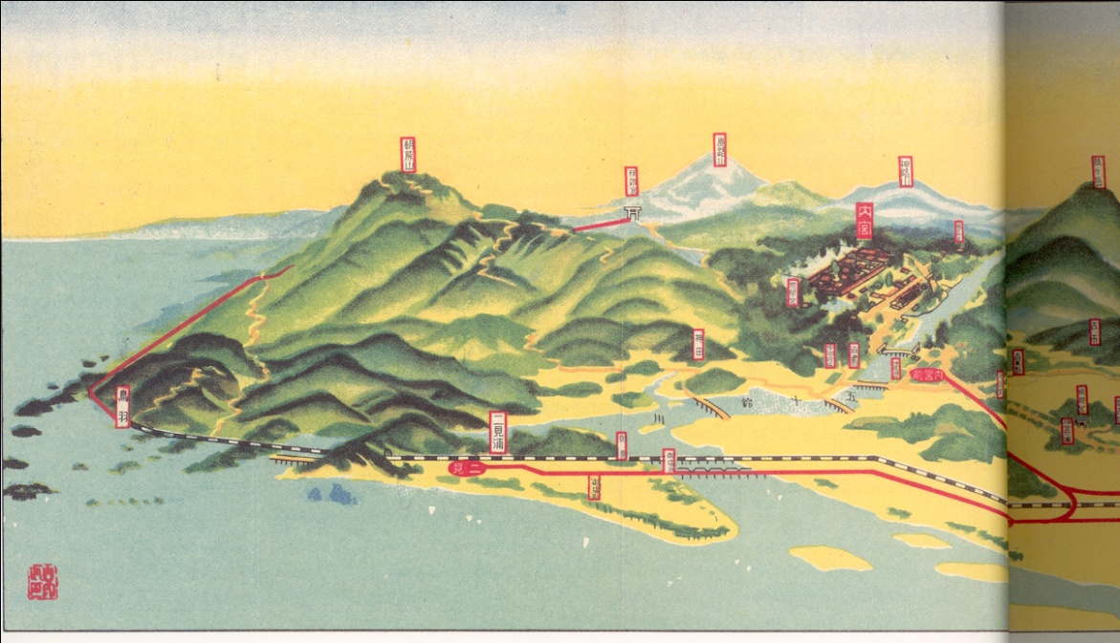
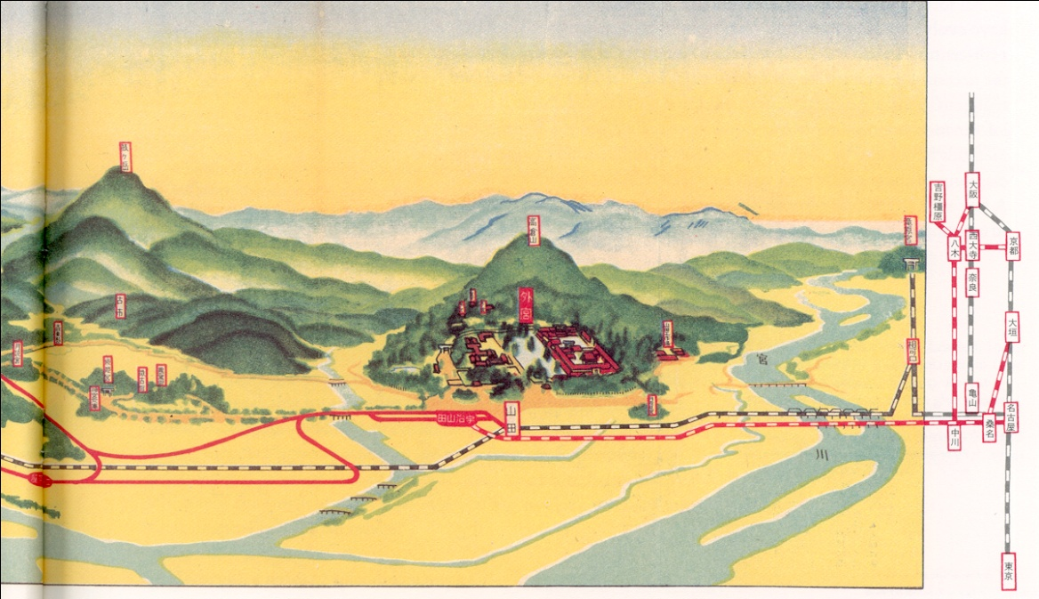
6. Consider 3D carefully – 3D graphic excellence
Notes:
IN this Japanese travel guide, an engaging hybrid of design technique, the abrupt shift from friendly perspective to hard flatland shows the loss suffered by giving in to the arbitrary data-compression of paper surfaces. A bird's-eye view with detailed perspective describes local areas near the architecturally renowned Ise Shrine; then, on the right margin, a very flat map delineates the national railroad system linking the shrine to major cities, somewhat compensating for loss of a visual dimension with a broad overview.

Slide 78
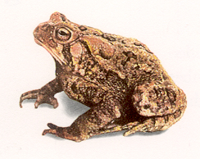
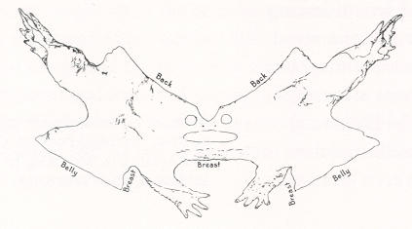
6. Consider 3D carefully – why 3D?
The world is 3D – 2D graphics flatten data
Notes:
When the toad (Bufo americanus Le Conte) sheds its skin upon the occasion of a quarterly moulting, the suit leaves life's spaceland and collapses into flatland, not unlike our information displays

Slide 79



6. Consider 3D carefully – why 3D?
Consider these early suggestions for periodic table
Notes:
Usualy Multivariate data is difficult to draw in 2D

Slide 80

6. Consider 3D carefully – why 3D?
Notes:
Sometimes 3D can be useful, For example in this case, Fold-up geometrical illustrations in the first English edition of Euclid’s ‘Elements of Geometry,’ published London, 1570 shows his mathematical contribution very clearly and it gives the viewers to experience it by playing around with the papers.

Slide 81

6. Consider 3D carefully – 3D graphic excellence
Notes:
Here we have a 3d diagram of physical components that go together. This diagram was published by IBM and it shows the instructions of how to assemble a copier machine. You can see how displaying the information in 3D format in this diagram is necessary.

Slide 82

7. Consider colour carefully
Avoid over powering
and garish colours
Notes:
Rainbow colors are overused in infographic but the problem with them is it is hard to judge which is greater than which color.
Also when you have more than 5-7 colors, distinguishing them can be difficult
Also you need to consider color blind ppl which makes choosing the right colors even harder.
This is a misleading rainbow

Slide 83




Notes:
Tufte offers considerable guidance on the use of colour in Chapter 5 of [40], as usual contrasting its power when used well against the calamities that can occur when inexpertly deployed.

Slide 84

7. Consider colour carefully
Notes:
Use least possible emphasis colours on clam background

Slide 85


8. Narrative of space and time
Notes:
The record sale of different music bands from 1955 to 1974

Slide 86

8. Narrative of space and time
Notes:
LIKE the tour-guides for the Ise Shrine and sunspots, movements are again explained on a perspective map in here, So you can say movement is the 4th dimention the flatland of floor, coded gestures in dance notation of body motion, and time sequence.

Slide 87

8. Narrative of space and time
Notes:
Use least possible distinguishable difference

Slide 88


Slide 89

Notes:
http://www.designyourway.net/blog/inspiration/when-infographics-go-bad-or-how-not-to-design-data-visualization/

